Slide 1

Newsletter
Week beginning 30.9.24
We are committed to safeguarding children.
Designated Child Protection Officer: Hannah Maskell
Deputy Child Protection Officers: Lorraine Dudman and Ann King
Named Governor for Child Protection: Jane Young

Slide 2

Please share with family, friends, neighbours or anyone looking for a place from September 2025 for reception class or indeed right now. We are able to offer personalised tours.

Slide 3
Secondary School applications
Children born between 1 September 2013 and 31 August 2014 will start Secondary School in September 2025.
You must apply by 31 October 2024.
If you apply after 31 October your application will be considered late and may be at a disadvantage.
The online application system is open until the 31 October 2024.
If you have any queries, or you are unable to apply online, please call 01803 208908 or email pupil.services@torbay.gov.uk to request an application form.

Slide 4
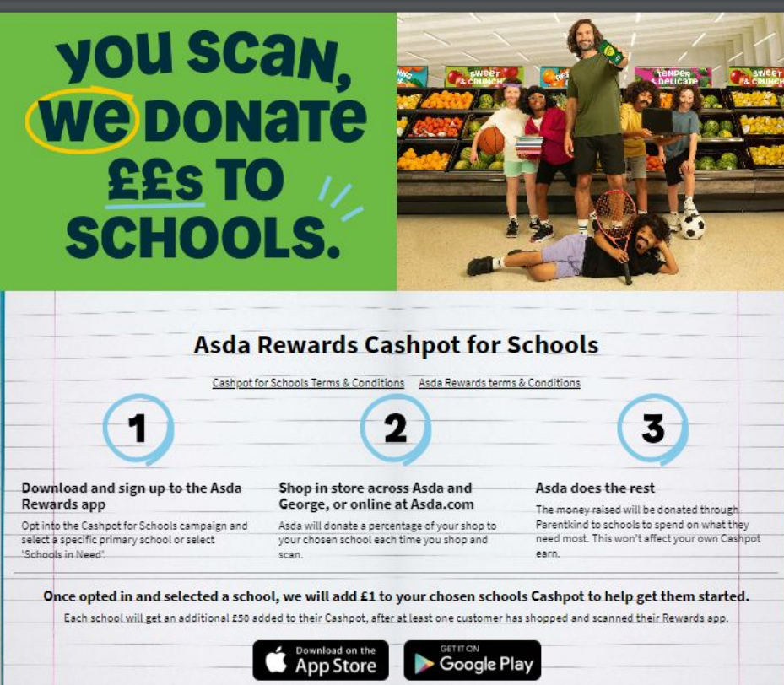
Asda Rewards Asda will donate 0.5% of your total spend each time you shop to our school. Please sign up today! Don’t forget to select our school! £90.67 raised so far!

Slide 5

Attendance this week for the whole school:
Class percentages:
Buttercup Class
Bluebell Class
Daffodil Class
Sunflower Class

Slide 6
Parent Evening Appointments
Parent evening appointments will be on Monday 14th October and Tuesday 15th October.
Link for booking -Monday
https://docs.google.com/document/d/10SO-mYNSV0vD55cvaJtL1SWG6fvlTr_aAsYcVtgeKQ4/edit?usp=sharing
Link for booking- Tuesday
https://docs.google.com/document/d/1wIud_r03T7GO0eYeZrZEUwWcKEOUTjswpxWhOFmOewg/edit?usp=sharing

Slide 7
Uniform
On Tuesdays and Wednesdays, Buttercups and Bluebells are able to wear their P.E kit into school for the day to maximise the length of time in P.E lessons.
Uniform Reminder:
We pride ourselves on wearing our uniform to show we are part of the Priory Family. Please be reminded that our uniform consists of the following:
Grey trousers/skirt and grey tights if wearing a grey skirt. (If still wearing a navy blue skirt, then tights should be navy blue too).
Up until October half term, children should be wearing either a royal blue polo shirt or a summer dress. If wearing winter uniform, a tie must be worn with their white shirt.
White polo shirts are not part of our uniform, nor are pale blue polo shirts.
School shoes must be plain black whether these are trainers or shoes.
Spare uniform is available as part of our uniform swap so please ask in the office if you need anything in particular.

Slide 8
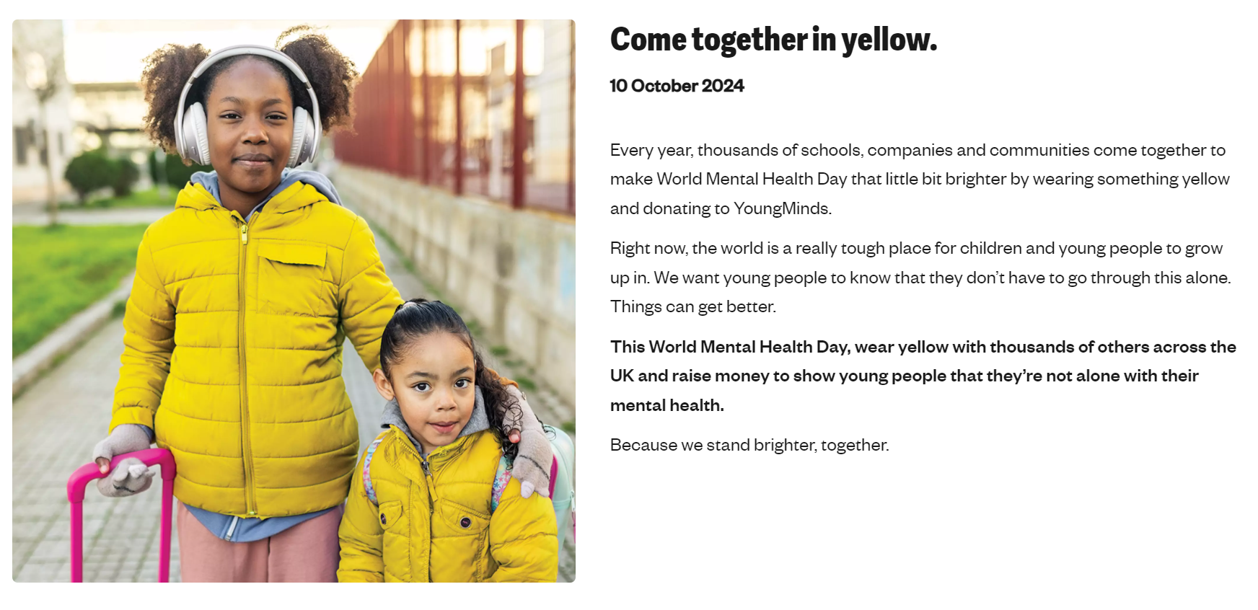
WEAR YELLOW NEXT THURSDAY FOR WORLD MENTAL HEALTH DAY

Slide 9

AWARD WINNERS THIS WEEK
Class | Witness Of The Week | Awesome Achiever | Star Reader | P.E award
WC: 30/09/24
Buttercups | Isabelle M | Birdie | Piper | Luna-Blue
Bluebells | Jaylee | Astrid | Jessica | Henry J
Daffodils | Jacob | Nishan | Jaynie | Zakary
Sunflowers | Annabella | Shaun | Junior | Bennie

